Slide 1
AI based Noise Reduction, Sharpening & Upsizing for Wildlife Photographers
Peter Batty • MHWPC Digital Training • May 12, 2026

Slide 2
Today's Session
Comparison Website
Full-resolution examples you can explore
Key Concepts
Noise, sharpening, upsizing — and how AI changes things
Demos and Comparisons
Demos and comparisons of Lightroom Classic, DxO PureRAW, Topaz Photo, ON1 RAW
First for Noise Reduction and Sharpening, then for upsizing
Summary and Recommendations
Which tools, when, and why

Slide 3
Full-Resolution Comparisons
pmbatty.github.io/battyphotos
Every example from today — all tools, all settings — at full resolution.
Side-by-side comparison mode with synchronized zoom.
AI-generated critiques from darwain analyzing each variant.
Open the link now if you'd like to follow along — or explore it at your own pace after the session.

Slide 4
Key Concepts
What you need to know before we dive into tools

Slide 5
Why This Matters
AI has transformed noise reduction, sharpening, and upsizing
We can dramatically improve some existing images, in some cases rescuing images that weren't usable before
We can change the camera settings we use with the knowledge of what these tools can do — in particular not being afraid to shoot with higher ISO
Heavier crops become viable with AI upscaling

Slide 6
Ethics & Contests
Generally Accepted
Noise reduction — seen as improved version of existing tools. Modest sharpening for slight softness.
Grey Area
Aggressive AI sharpening, motion blur recovery, and upsizing — the AI is inventing plausible detail. Most contests don't specifically address this in their rules yet.
MHWPC Contest Rules
Images may be enhanced using any post-processing tools, except you cannot copy or significantly alter the primary subject, nor import from another image. The intent of the original must be maintained.
No restrictions for the Creative category.
For club work: currently the tools we show today are fine, but as a club we will need to think about rules going forward. More creative generative AI tools are more problematic.

Slide 7
How AI Tools Are Different
Noise Reduction
Traditional NR applies spatial filtering — averaging nearby pixels, which smears fine detail. AI NR predicts what the clean image should look like, preserving feathers, fur, and texture.
Sharpening
Traditional sharpening enhances edge contrast — it can't add detail that isn't there. AI sharpening can recover or generate plausible detail from soft or blurred originals.
Upsizing
Traditional upscaling interpolates between pixels. AI upscaling generates plausible new detail — enabling larger upscaling of heavy crops.
How They Work
Trained on millions of before-and-after image pairs, AI models learn to predict the improved version. Some can denoise, sharpen, and upscale simultaneously.

Slide 8
Four Tools
Live demos + comparison results from the website

Slide 9



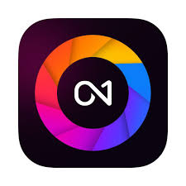
The Tools We're Comparing
Adobe Lightroom Classic
DxO PureRAW
AI Denoise • Super Resolution
Built-in, non-destructive, no extra cost
DeepPRIME XD3 • Lens corrections
Works on RAW • $129 one-time
Topaz Photo
ON1 Photo RAW 2026
Denoise • Sharpen • Upscale
Best sharpening • ~$199/yr subscription
NoNoise AI • TackSharp AI • Resize AI
Non-destructive • ~$100 perpetual

Slide 10
1: Lightroom Classic
Non-destructive AI Denoise function (since June 2025)

Slide 11
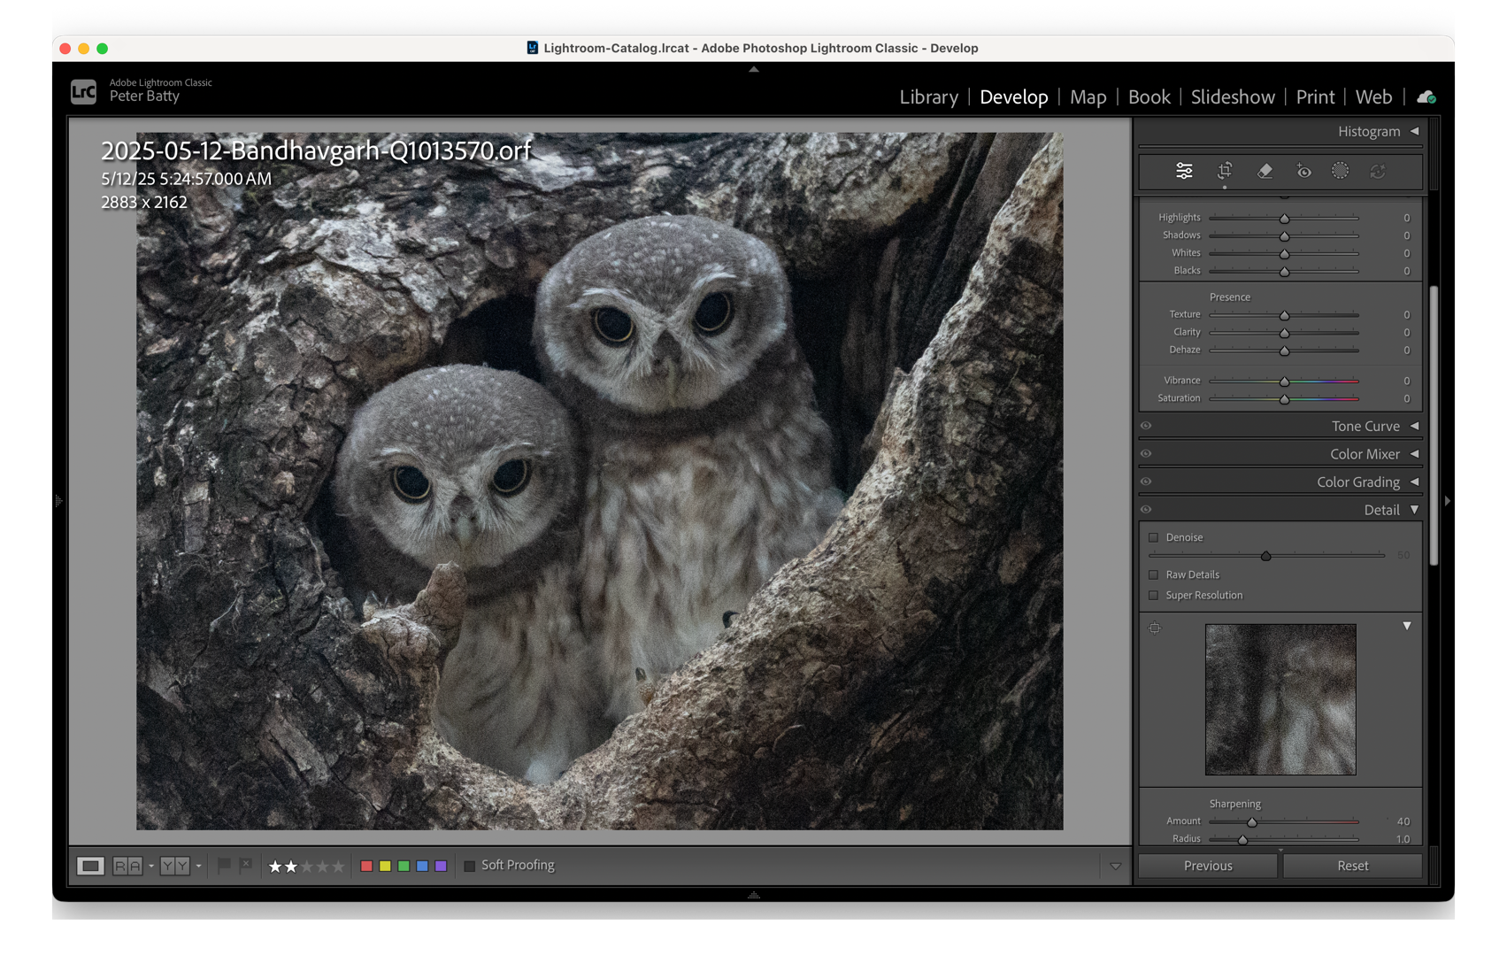
Demo

Slide 12
Lightroom Classic AI Denoise
Strengths
Quick and simple
Surprisingly good — holds up well against specialized tools
Built into Lightroom — no extra cost, no export/import workflow
Fully non-destructive
Can apply at any stage of editing
Limitations
AI Denoise works on RAW only
Limited control — just one strength slider
No AI sharpening for missed focus or motion blur
No localized/selective processing
Not directly compatible with Lightroom “Super Resolution” upscaling (except by saving file as TIFF or other first)

Slide 13
2: DxO PureRAW
RAW pre-processing with lens and camera mathematical model foundation

Slide 14
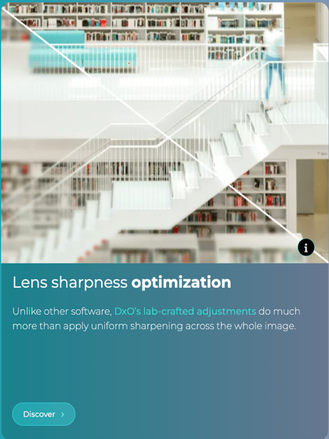
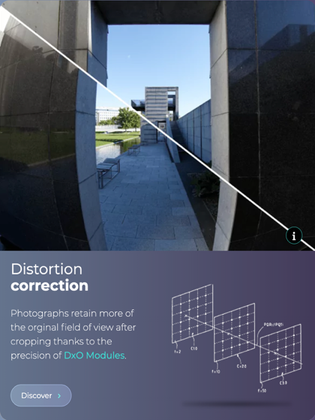
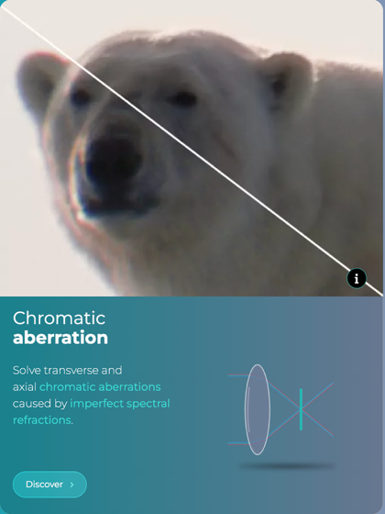
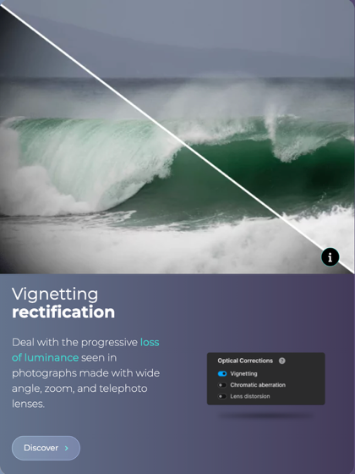
DxO technologies
https://www.dxo.com/dxo-pureraw/technologies/

Slide 15
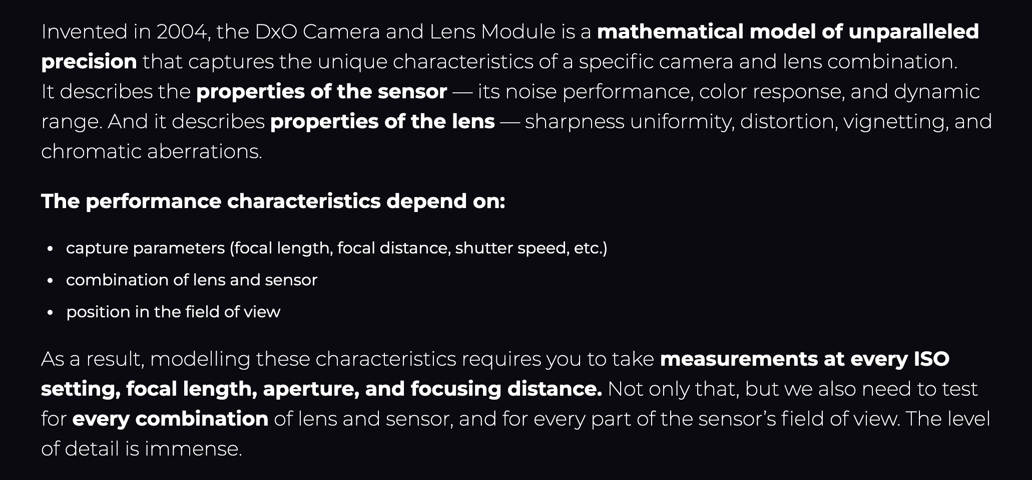
DxO Modules – a foundational element

Slide 16
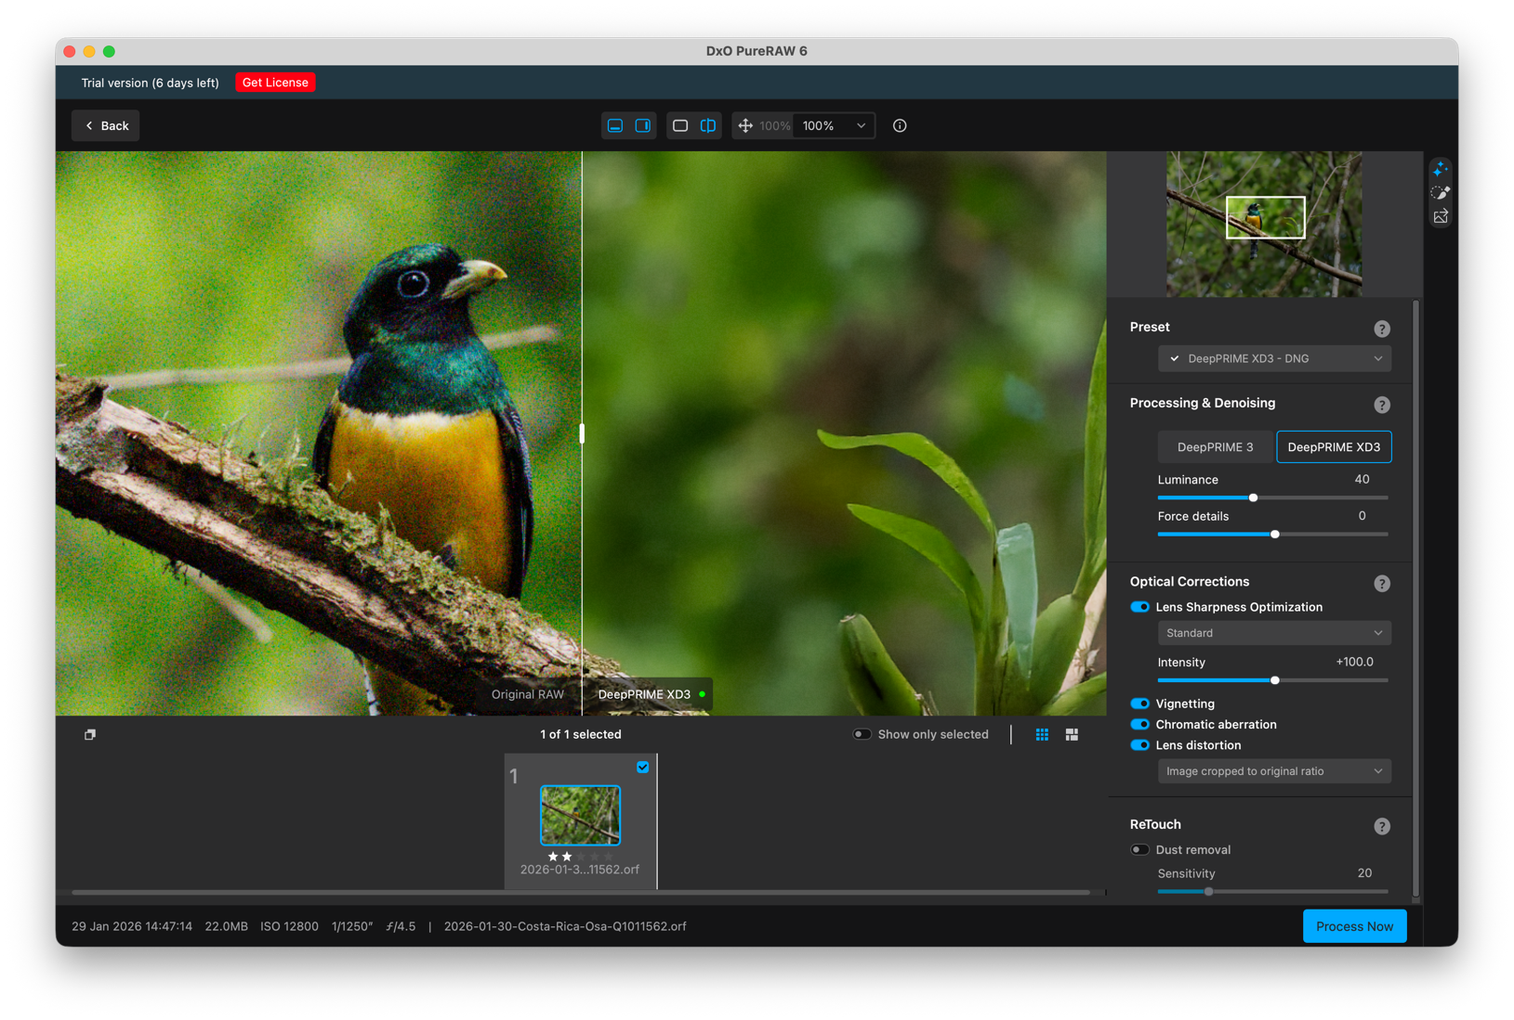
Demo

Slide 17
DxO Pure RAW
Strengths
Outstanding quality for noise reduction and moderate sharpening
Relatively quick and simple
More options available than Lightroom
Can run in batch
Doesn’t introduce artifacts like Topaz can
Creates DNG files
Can sharpen more than I expected with “Strong” and “Hard” settings
Consistently wins in my AI rankings and in most reviews
Limitations
No aggressive AI sharpening for bad cases of missed focus or motion blur
No localized/selective processing
$129 one-time purchase
No subscription required
14 day free trial

Slide 18
3: Topaz Photo
The AI sharpening leader

Slide 19
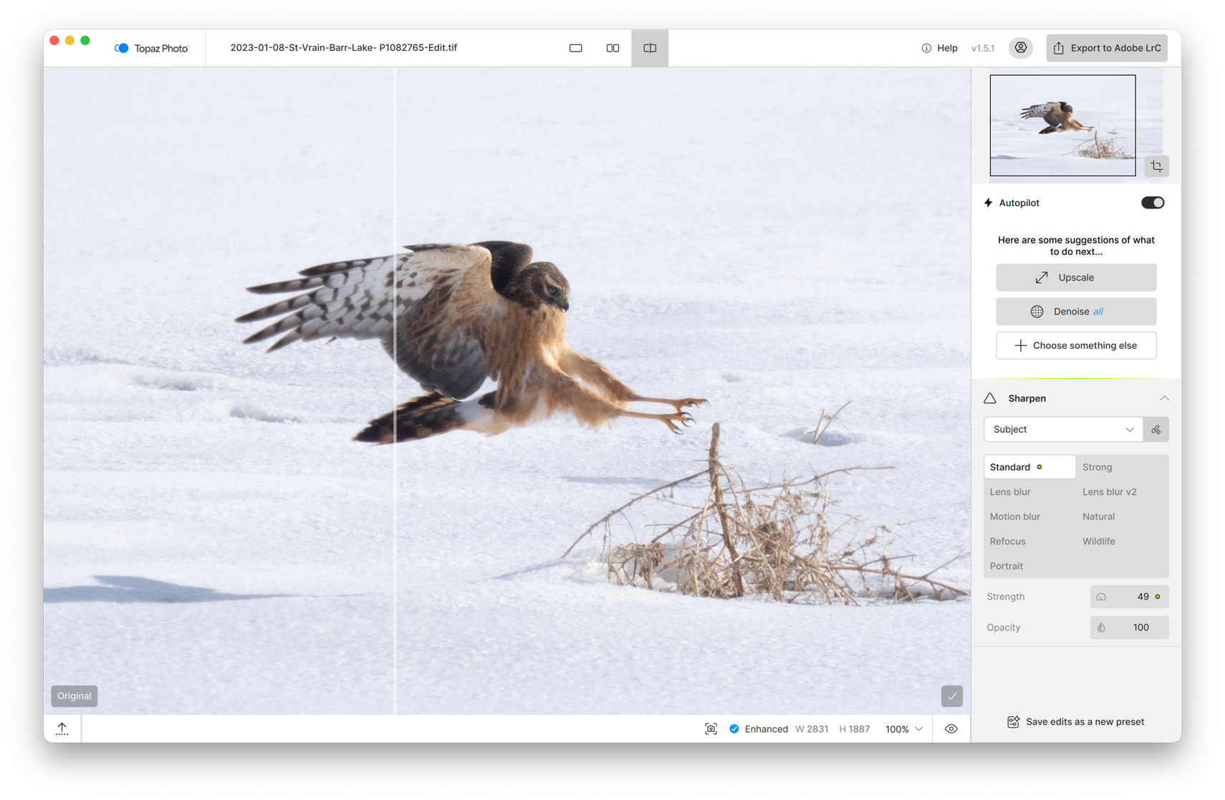
Demo

Slide 20
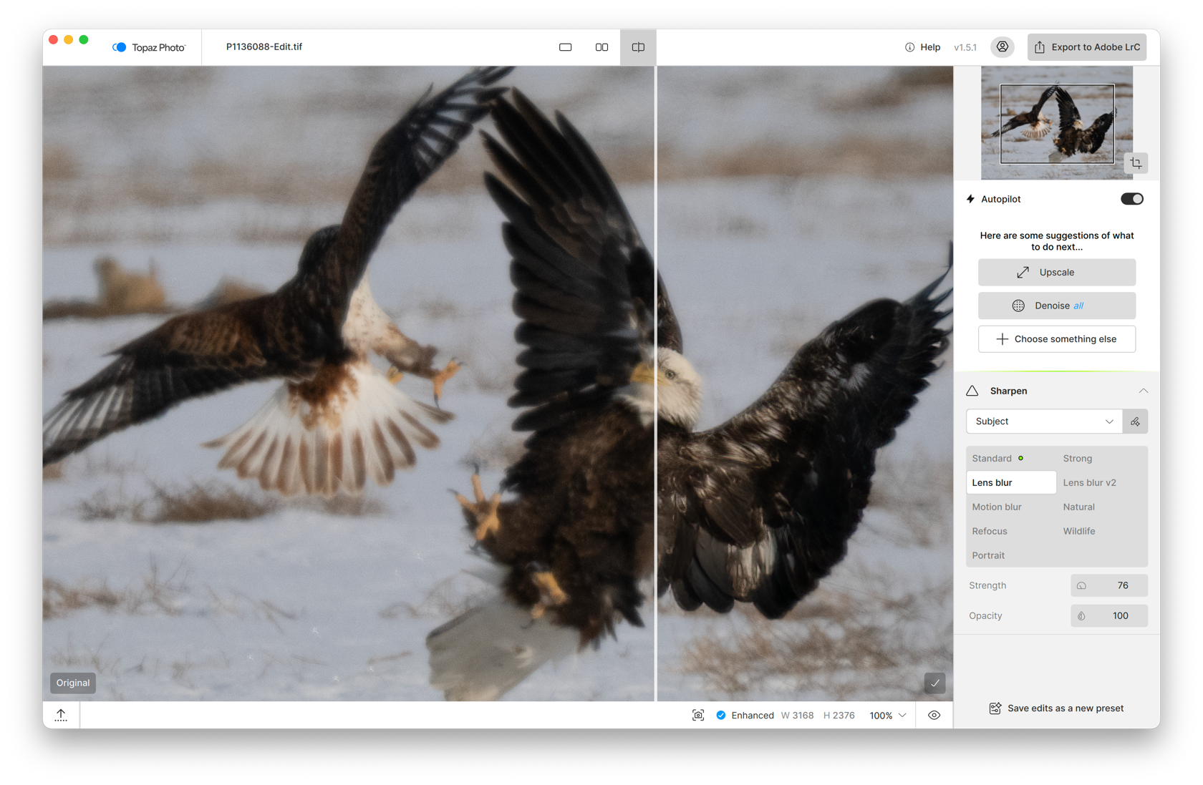
Demo

Slide 21
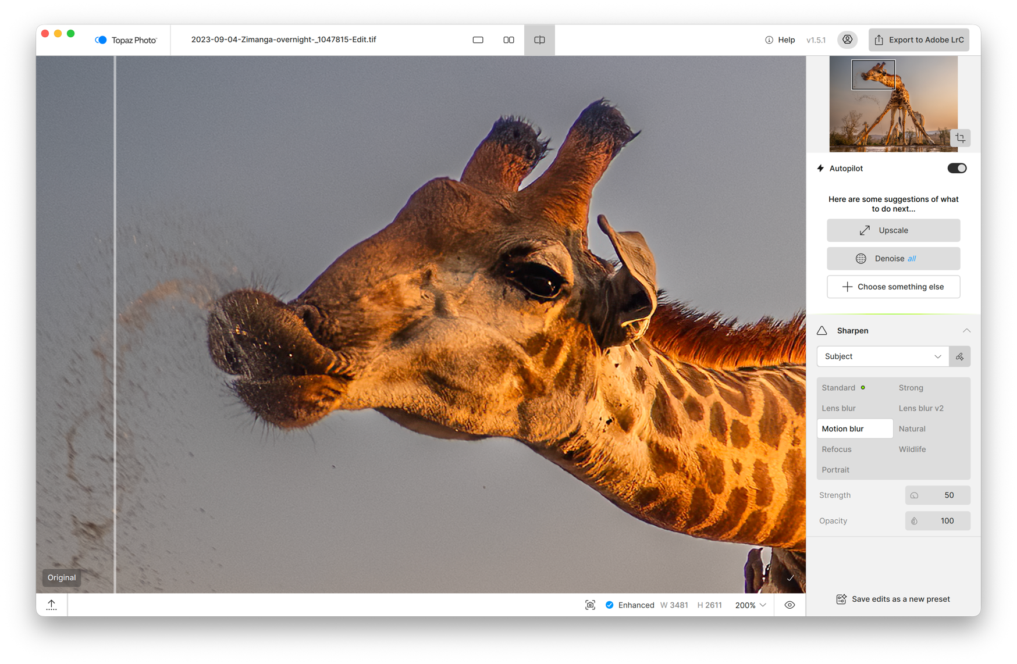
Demo

Slide 22
Topaz Photo — Strengths
AI sharpening can recover missed focus and motion blur in many cases
Multiple AI sharpening models including Lens Blur, Motion Blur, Wildlife (new)
Simple, effective masking
Sharpening on subject only is desirable in many wildlife scenarios
Integrated upscaling up to 6x

Slide 23
Selective processing workflow options
Whole Image
Denoise all → sharpen all. Simple but can introduce artifacts.
Subject-Only Sharpen
Denoise all → sharpen subject only. Topaz default — avoids sharpening bokeh.
Split by Region
Denoise background only → sharpen subject only. Can be helpful in some situations where subject has delicate textures that get smeared with Denoise

Slide 24
Topaz Photo — Cautions
Default settings often too aggressive
Can over-sharpen and introduce artifacts
Consider reducing sharpening strength from recommended values
Be wary about sharpening images that are already sharp — easy to overdo
Noise reduction can smear detail more than Lightroom or DxO in some cases
Topaz has a history of changing product line frequently – various products have been discontinued and you need to upgrade to newer ones
Keep in mind that viewing context matters. An image that looks "over-sharpened" at 100% may look better than a softer version at contest resolution (1400×1050) or on social media.
Subscription ~$199 per year
No more perpetual licenses (except for legacy products)

Slide 25
4: ON1 Photo RAW
The all-in-one alternative

Slide 26
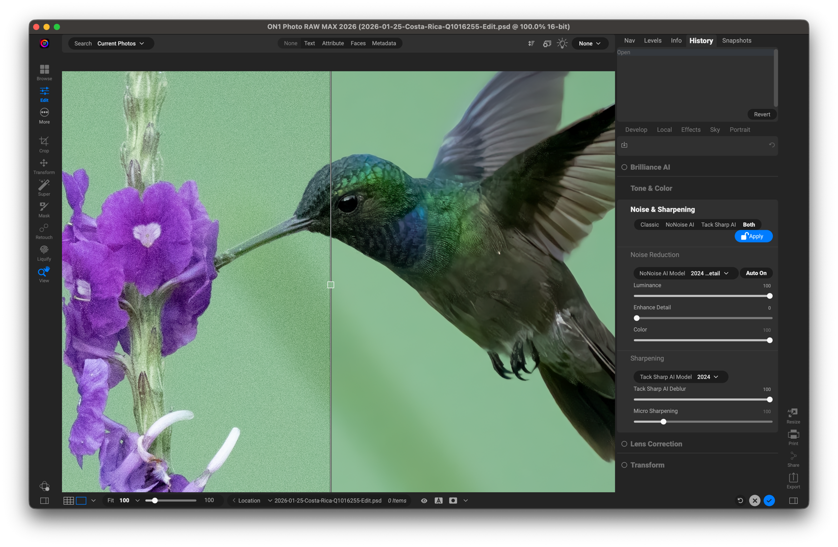
Demo

Slide 27
ON1 Photo RAW 2026
Strengths
Lower cost alternative to Topaz, with AI sharpening capabilities that Lightroom and DxO don’t have
Some additional capabilities in Resize AI compared to other options (tiling, print wrap)
Full photo editing and management tool that combines many elements of both Lightroom and PhotoShop in a single non-destructive environment
Limitations
Localized sharpening more complex than Topaz — requires layers + masks
Can over-sharpen like Topaz
Results not as good as other tools in most of my tests – but didn’t do local sharpening because of complexity
~$100 perpetual license (full editor) or ~$50 for NoNoise standalone

Slide 28
5: Topaz Gigapixel
Simple upsizing

Slide 29
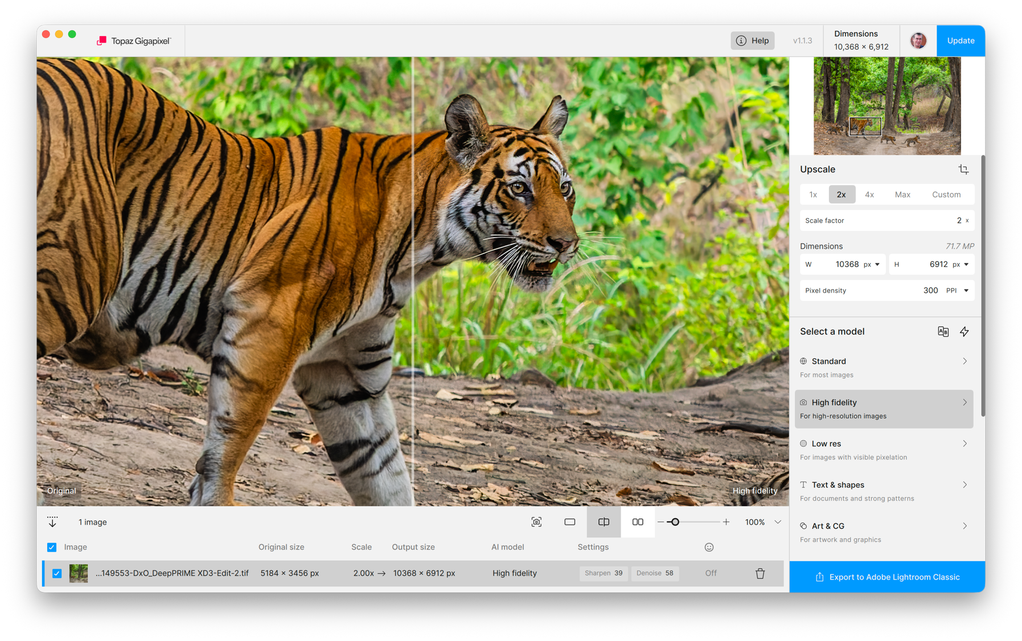
Demo

Slide 30
6: ON1 Resize AI
Part of ON1 RAW, also available standalone

Slide 31
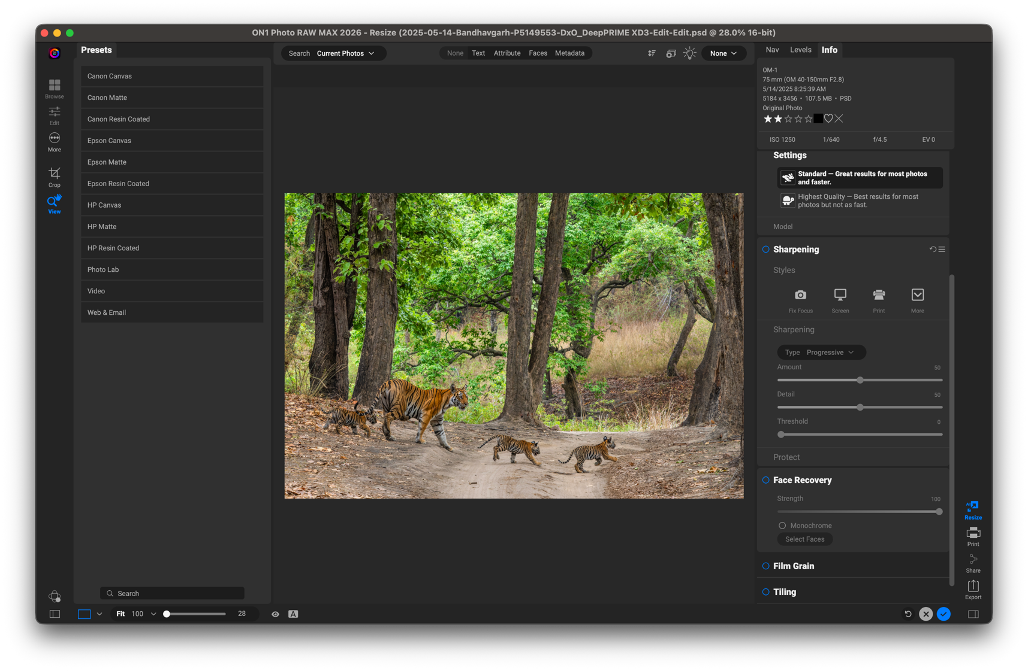
Demo

Slide 32
Summary and Recommendations
Which tool, when, and why

Slide 33
Situation influences tool choice
Quick high volume edits versus longer low volume edits
Depends on your workflows and preferences
Output resolution
For lower resolution, like MHWPC or Share the View contests, or social media, less effort is needed than for larger prints, or contests that require full resolution images

Slide 34
Pros and Cons of different tools
Lightroom AI Denoise AI is very good!
For Lightroom users, this is very quick and convenient and good enough in many situations, especially for lower resolution output, unless you need more aggressive sharpening
DxO PureRAW is outstanding
For the very best image quality, highly recommended. It can handle moderate sharpening with appropriate settings. You can use Topaz too if for more aggressive or selective sharpening.
Topaz is the best option when you need more aggressive sharpening for missed focus or motion blur. Easy to use selective sharpening. Beware of oversharpening.
ON1 is potentially a more cost competitive alternative to Topaz, but selective sharpening is a lot more complex and in general its results were not as good as the other options
It does have good potential as a non-destructive replacement for Lightroom and PhotoShop, but full evaluation of this is beyond the scope here.

Slide 35
General takeaways
Don’t be afraid to use high ISO
These tools do an excellent job of cleaning up noise
There are benefits for small sensors
Micro four-thirds and crop sensors tend to have more noise than full frame sensors, but these AI tools largely make this a non-issue.
Upsizing images also factors here, making lower megapixel sensors less of an issue in many cases

Slide 36
Resources
Online viewer
pmbatty.github.io/battyphotos
Tool Websites
adobe.com/products/photoshop-lightroom-classic.html
dxo.com/dxo-pureraw
topazlabs.com/topaz-photo
on1.com/products/photo-raw
DxO Technology Deep Dive
dxo.com/dxo-pureraw/technologies
These slides and all links will be shared after the session.

Slide 37
Questions?
pmbatty.github.io/battyphotos

